Slide 1
IDP Project Slides for 10.05.24
Dominik Hack
Supervisor: M.Sc. Paula Villa Fulton
Chair of Human Movement Science

Slide 2
Research Question
“How can machine learning algorithms utilizing IMU data be optimized to accurately differentiate between activities-of-daily-living (ADL) and non-activities-of-daily-living (Non-ADL)?”

Slide 3
Anomaly Detection
Our normal expected data are ADL
Rare exceptions like driving are Non-ADL
Algorithms to consider based on https://arxiv.org/abs/2004.00433
Statistical approach:
AR-Model
Machine learning approaches:
Semi-Supervised:
One-Class Support Vector Machine
Unsupervised
Isolation Forest
Clustering
Deep learning approach:
Auto-Encoder

Slide 4
Clustering
K-means:
Defining a desired number of distinct and non-overlapping clusters k
K-Means algorithm is executed on dataset until it converges, resulting in k centroids
DBSCAN:
Also analyses the density in the data
Marks dense regions as clusters and points in low-density areas as outliers
Better suited for non-spherical clusters

Slide 5
Clustering – Results of Example Implementations

Slide 6
Isolation Forest
Builds an ensemble of Isolation Trees (binary trees isolating data points)
Anomalies are few and different, thus easier to isolate from rest of the data

Slide 7
One-Class Support Vector Machine
Training set consists of only normal data
Test data is then either normal or anomaly data

Slide 8
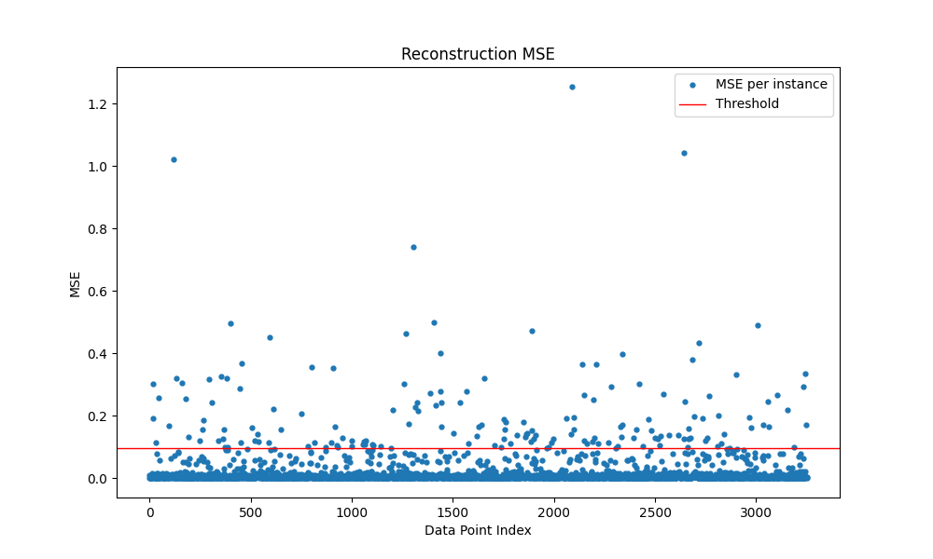
Auto-Encoder
Reduce the dimensionality of the data and to project it on a lower space
Normal and abnormal data are significantly different on this space
Projecting back to the original space will show significant differences in some data points

Slide 9
Autoregressive-Model
Models current value of time series as a function of its previous values
Statistical approaches should perform better for point anomalies
Non-AOL are contextual anomalies -> machine learning models should perform better
Example Implementation will follow next meeting

Slide 10
Questions
What are the residual and rot[x] columns in the dataset?
How to continue with the EgoExo4D-Data?
IMU Sensors are on the Head. Is this even useful?
Do I even need the dataset?
When and how do I get access to more patient data so I can evaluate the performance and tune the models?
Do I need to add more to my research question?

Slide 11
Detailed schedule
Uni and work are more time consuming than expected now -> Unfortunately I will need to postpone the original schedule
10.5 - 21.5:
Finish Implementation of AR
Test models on patient data with AOL and Non-AOL
Comparing the models
More literature research
22.5 - ???:
Tuning the models
Add additional topic to the research question
Analyze the results
Start with the thesis writing

